Slide 1

TITANIC “THE UNSINKABLE SHIP”

Slide 2
PROBLEM STATEMENT
The Titanic was a great and unexpected disaster in the early 1900’s. The “unsinkable” ship struck an iceberg causing fatal damage to the integrity of the ship.
This model is to accurately predict the survival of passengers aboard the ship the early morning of April 15th, 1912.

Slide 3

BUSINESS VALUE
Upskilling of entry level Data Scientists by tackling a binary classification problem which can then be used in real world applications.
Encouraging creative / ”outside the box” thinking to feature engineer and improve model performance.

Slide 4

METHODOLOGY
Analysis of Titanic data to understand key features of surviving passengers.
Binary classification using XGBoost.
Feature engineering to improve model performance and accuracy.
Bayesian Optimization of tuning parameters to target well fit models with high model scores.

Slide 5

Feature Engineering
New features:
Title of an individual
Family Size
Fare cost per Person
Parent: Mother / Father
Family Demographics
Feature Bin:
Family Size
Age

Slide 6
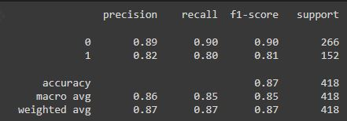
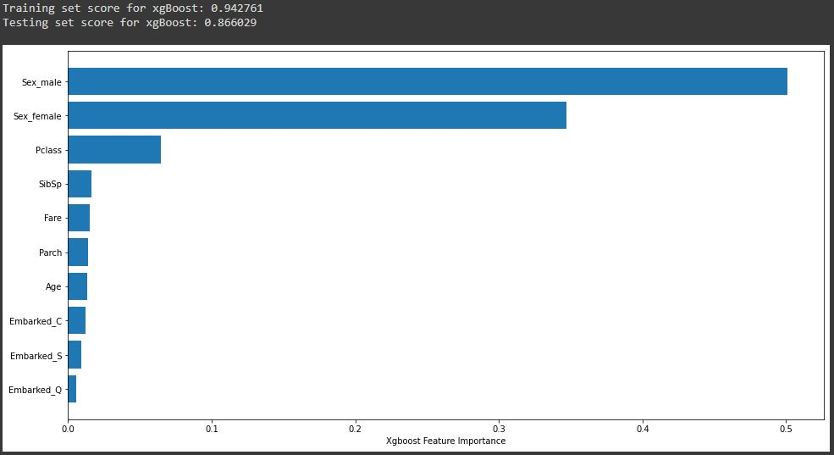
BASELINE MODEL
BASELINE MODEL RESULTS [Overfit]
Training Score: 94.2%
Test Score: 86.6%
Feature Importance:
Gender: Sex_male / Sex_female

Slide 7
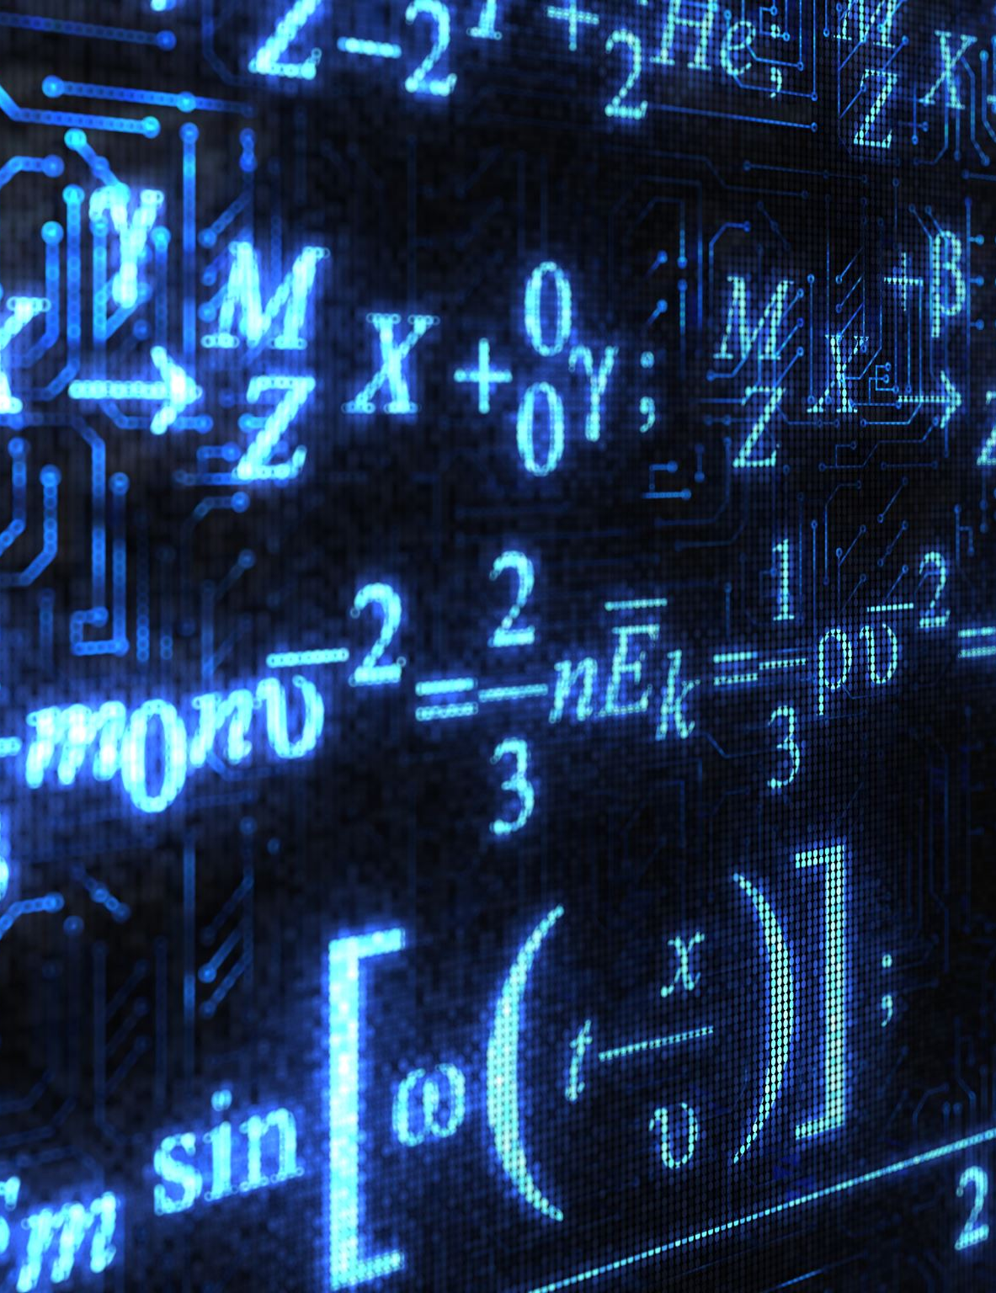
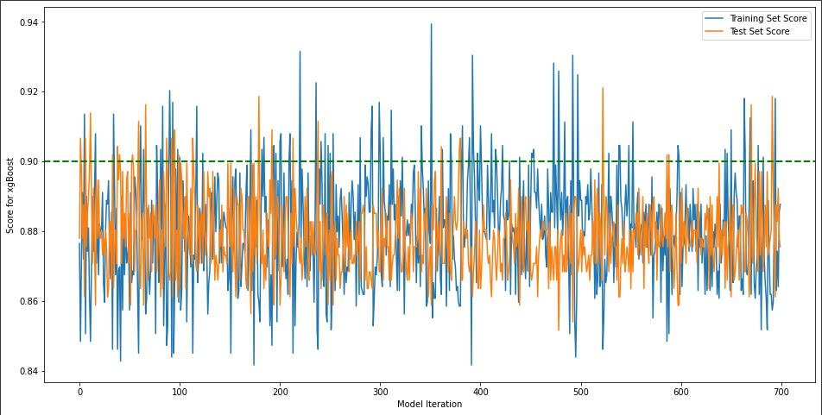
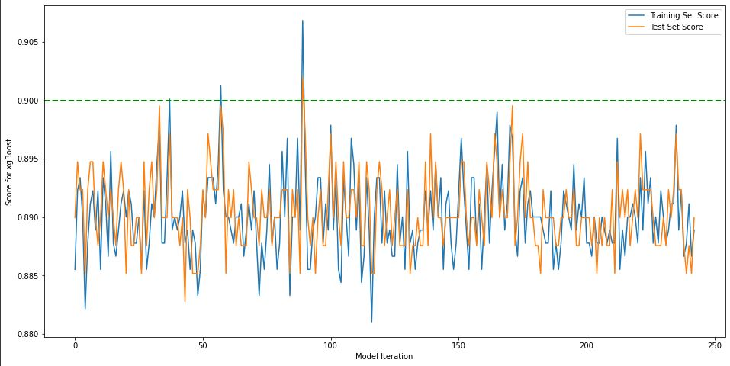
BAYESIAN OPTIMIZATION
Iteration of hyperparameter tuning to target ideal model performance.
Targeting hyperparameters that have an accuracy < 0.005

Slide 8
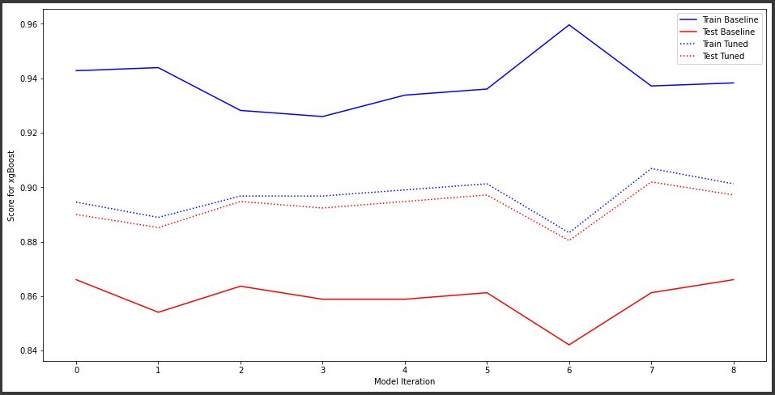


BASELINE / TUNED MODEL EVOLUTION
Feature Engineering Impact on Model Performance:
Bin of Family Size – Negative Impact 1.7%
Family Gender Count – Positive Impact 2.1%

Slide 9
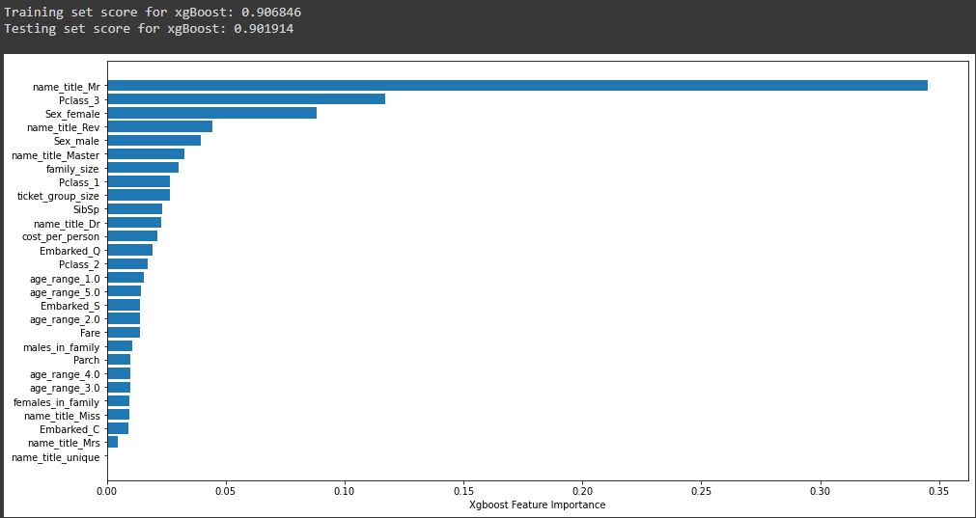
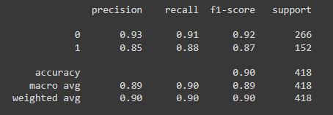
SUMMARY: BEST MODEL
BEST MODEL RESULTS
Training Score: 90.68%
Test Score: 90.19%
Feature Importance:
Gender: name_title_Mr / Pclass_3
Engineered features such as “name_title” and “family_size” ranked high in feature importance, yielding 50% of the top 10 important features.

Slide 10

FUTURE CONSIDERATIONS
Increase complexity of Bayesian optimization to expand the ”universe” of hyperparameters being tuned and their limits
Automating column selection to iterate all combinations of columns used and columns to one-hot encode
Utilizing GPU power to support more advanced optimization practices

Slide 11
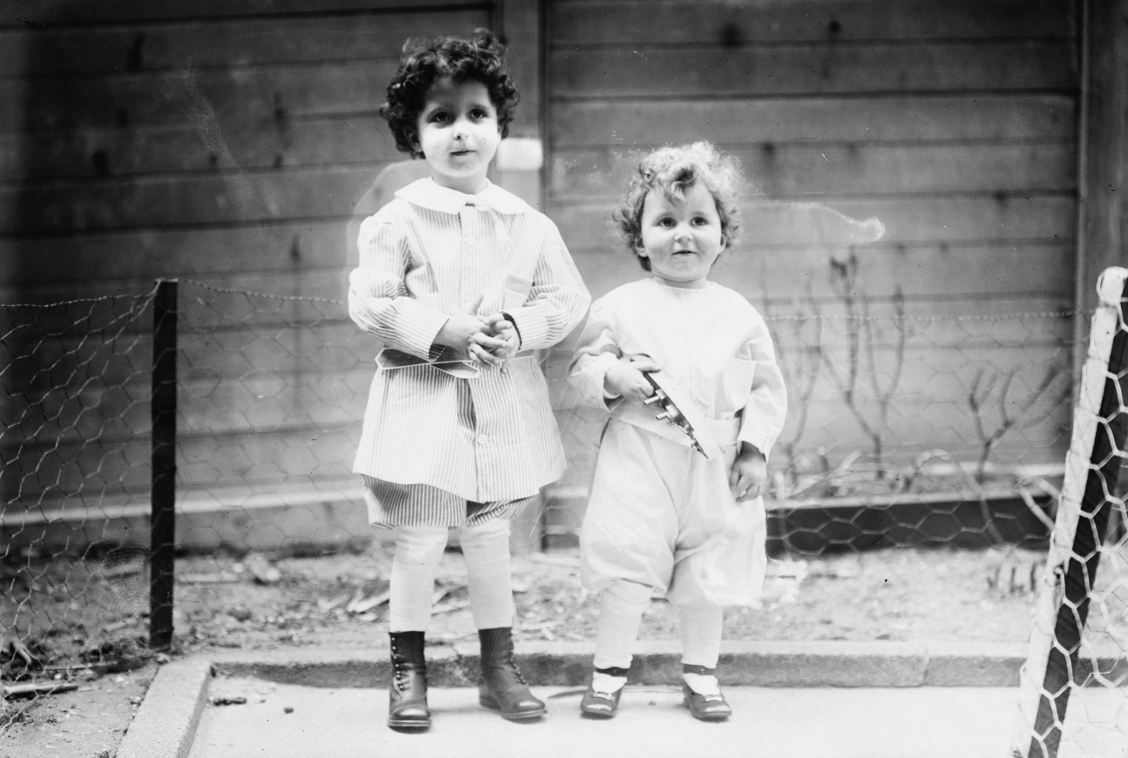
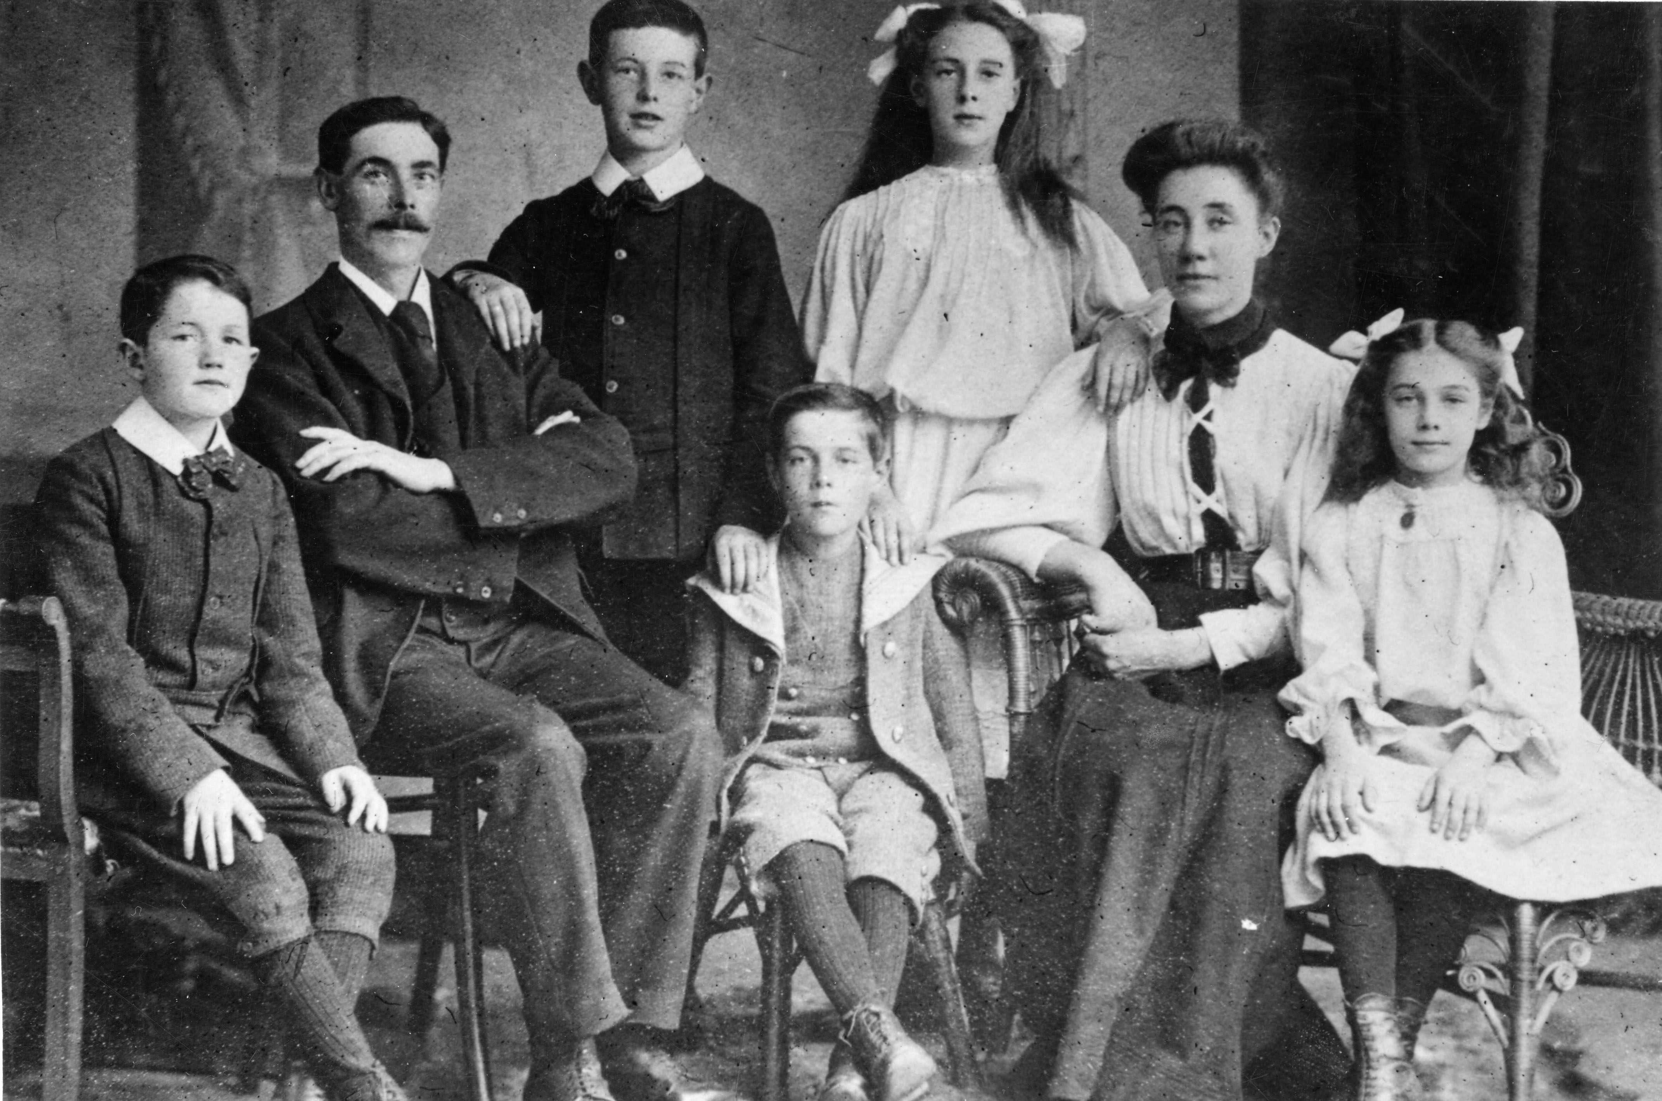
Thank you

